Slide 1

Aplikasi Warung Makan
Theofilus Handoyo

Slide 2
Timeline
Unit Testing
Requirement System
Specification
System Design
Entity Relationship design
Developing
Repository
Use Swagger UI
Testing
Documentation
UseCase
Controller
Software Architecture
Product Requirement
Deployment
Deployment
Deploy to Heroku

Slide 3
Agenda
Introduction
Master & Transaction table
JWT Authentication
Upload & Download
Transactional
Unit Testing
Deploy (optional)
Documentation API

Slide 4
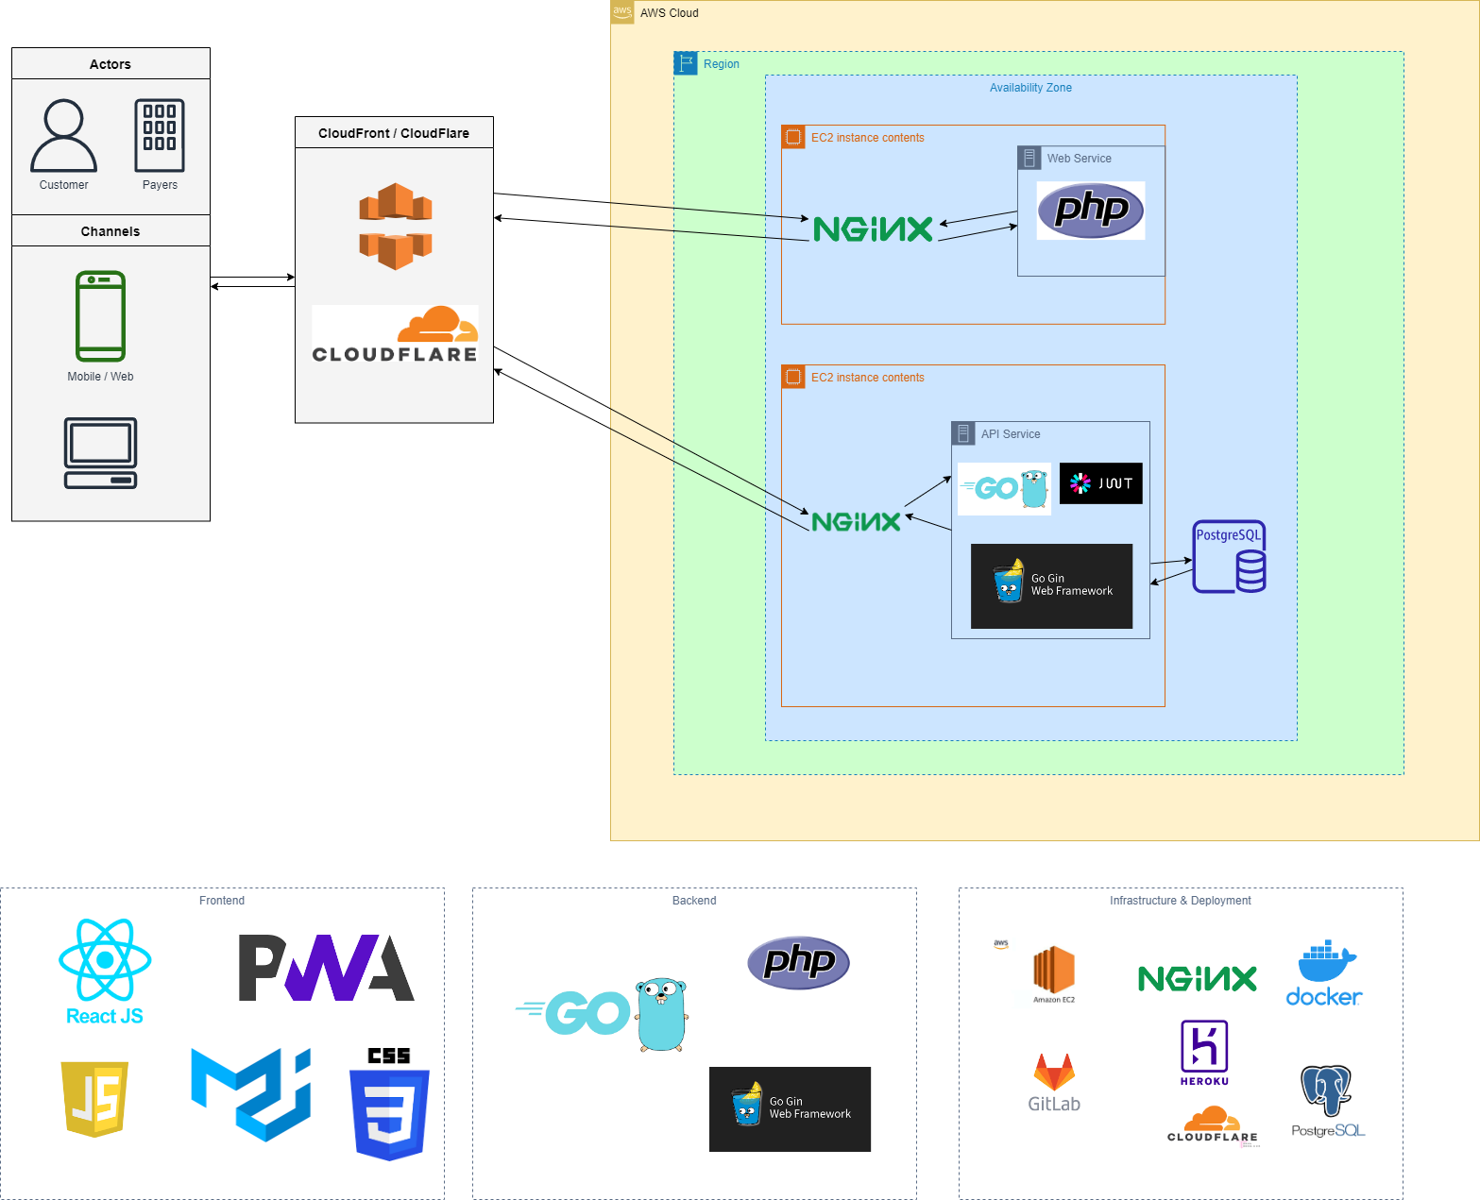
High Level Architecture

Slide 5
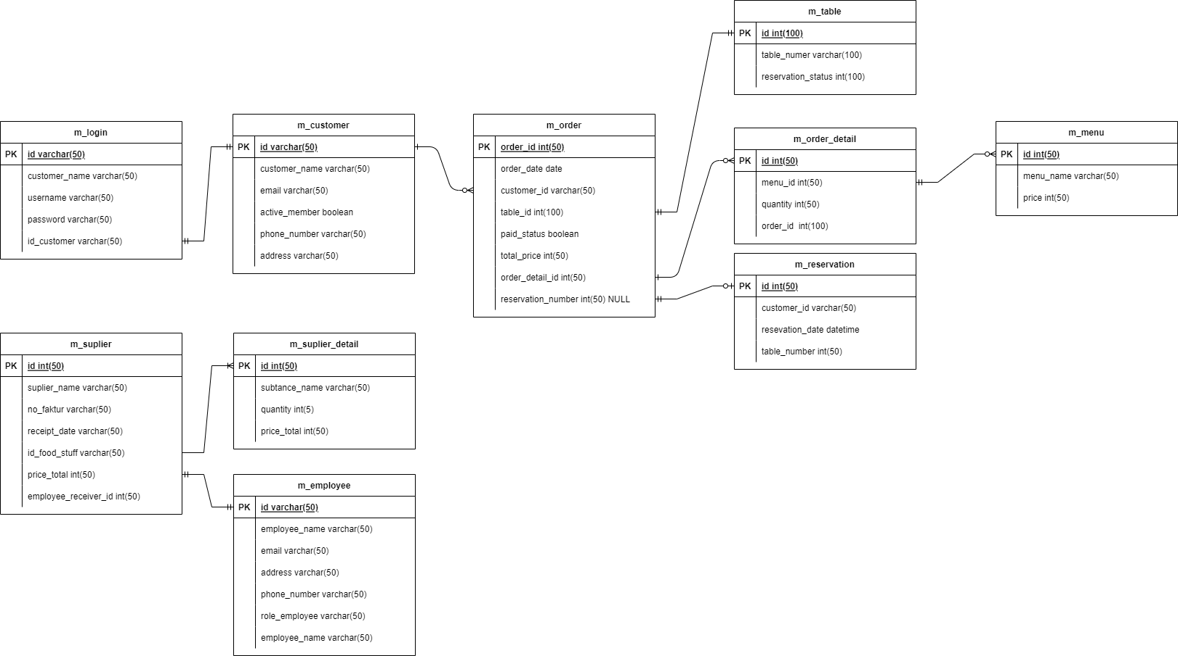
Entity Relatiotionship Diagram

Slide 6
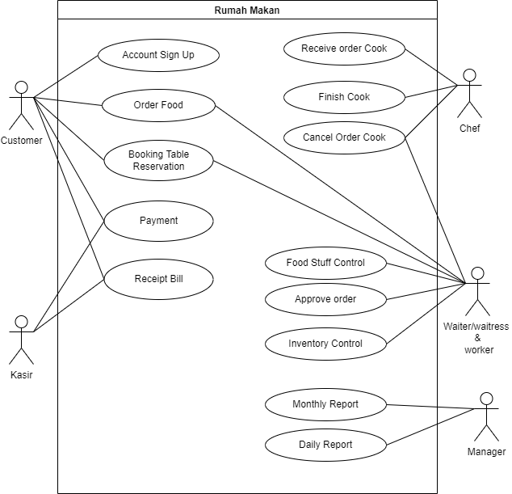
UseCase

Slide 7
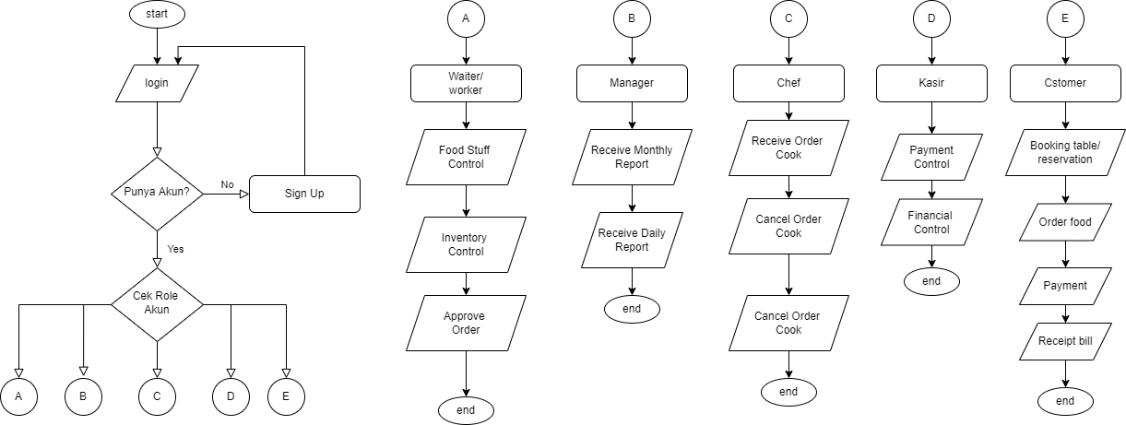
Flowchart

Slide 8
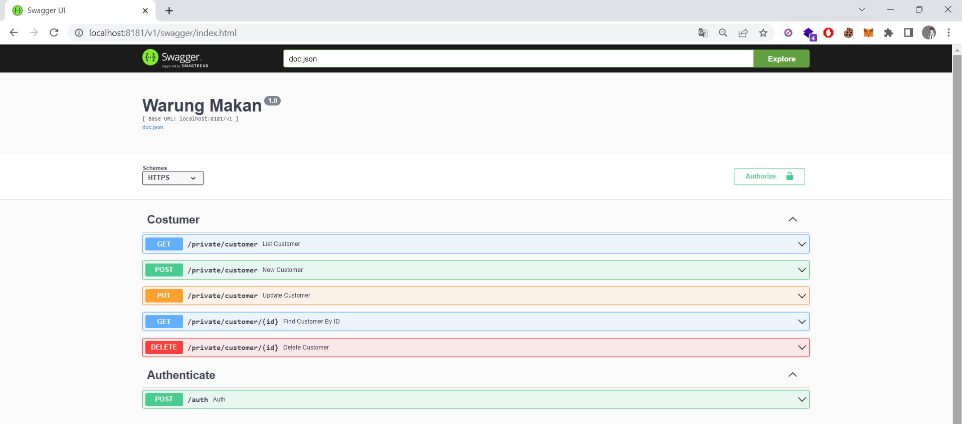
Documentation API
Localhost:8181/swagger/index.html

Slide 9
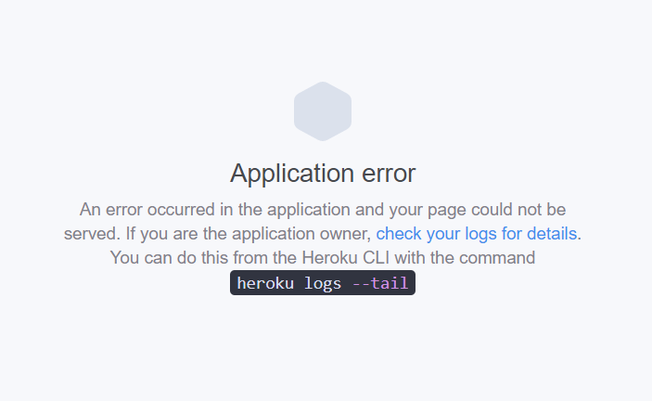
Deployment

Slide 10
Areas of growth
 | B2B | Supply chain | ROI | E-commerce
Q1 | 4.5 | 2.3 | 1.7 | 5.0
Q2 | 3.2 | 5.1 | 4.4 | 3.0
Q3 | 2.1 | 1.7 | 2.5 | 2.8
Q4 | 4.5 | 2.2 | 1.7 | 7.0

Slide 11
Business opportunities are like buses. There's always another one coming.
“
”
Richard Branson

Slide 12




Meet our team
Takuma Hayashi
Mirjam Nilsson
President
Chief Executive Officer
Flora Berggren
Rajesh Santoshi
Chief Operation Officer
VP Marketing

Slide 13








The full team
Takuma Hayashi
Mirjam Nilsson
Flora Berggren
Rajesh Santoshi
President
Chief Executive Officer
Chief Operations Manager
VP Marketing
Graham Barnes
Rowan Murphy
Elizabeth Moore
Robin Kline
VP Product
SEO Strategist
Product Designer
Content Developer

Slide 14
Plan for product launch
Deploy strategic networks with compelling e-business needs
Planning
Synergize scalable e-commerce
Marketing
Disseminate standardized metrics
Design
Coordinate
Foster holistically superior methodologies
Launch
Strategy
e-business applications
1
2
3
4
5

Slide 15
Areas of focus
B2B market scenarios
Cloud-based opportunities
Develop winning strategies to keep ahead of the competition
Capitalize on low-hanging fruit to identify a ballpark value
Visualize customer directed convergence
Iterative approaches to corporate strategy
Establish a management framework from the inside

Slide 16
How we get there
ROI
Niche Markets
Supply chains
Envision multimedia-based expertise and cross-media growth strategies
Visualize quality intellectual capital
Engage worldwide methodologies with web-enabled technologies
Pursue scalable customer service through sustainable strategies
Engage top-line web services with cutting-edge deliverables
Cultivate one-to-one customer service with robust ideas
Maximize timely deliverables for real-time schemas

Slide 17
Summary
At Contoso, we believe in giving 110%. By using our next-generation data architecture, we help organizations virtually manage agile workflows. We thrive because of our market knowledge and great team behind our product. As our CEO says, "Efficiencies will come from proactively transforming how we do business."

Slide 18
Thank you
Mirjam Nilsson​
mirjam@contoso.com
www.contoso.com

